Slide 1
Determination of castor seed fat content (based on T2 and calibration curve)
NMR and MRI Application in Biotechnology

Slide 2
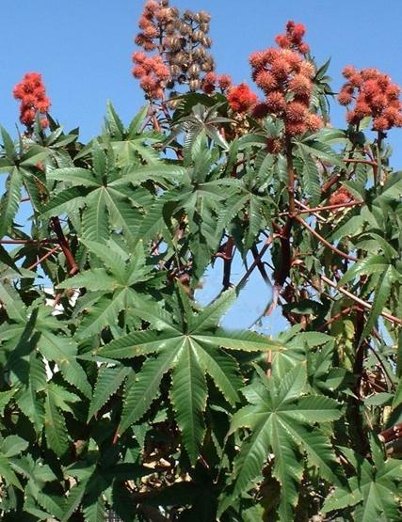
Castor Seed
Castor is an important non-edible oil crop, considered a vital industrial raw material.
They are poisonous to humans and animals since they contain the toxic protein ricin.
The plant is known to tolerate diverse weather conditions and it can grown on marginal lands that are usually unsuitable for food crops.
Castor seeds are available at low cost.
All these features make it an attractive alternative biodiesel feedstock.

Slide 3
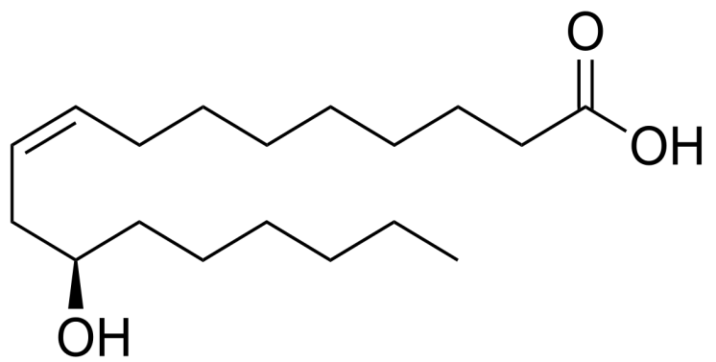
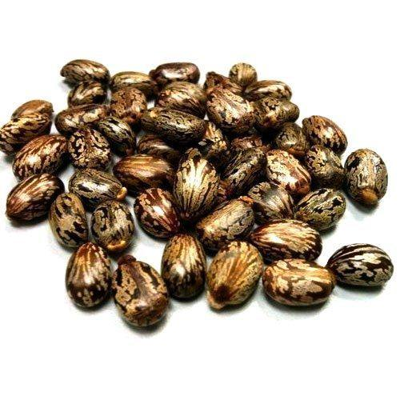
Castor Seed
Castor oil consists mainly of ricinoleic acid and its high content of this fatty acid results in extremely high viscosity of castor-based biodiesel.
Table 1-FA composition of Castor Seeds
FA composition (%) | Name | Structure
1.01 | Palmitic Acid | 16:0
1.10 | Stearic Acid | 18:0
3.30 | Oleic Acid | 18:1
4.61 | Linoleic Acid | 18:2
0.48 | Linolenic Acid | 18:3
0.29 | Eicosenoic Acid | 20:1
0.04 | Lignoceric Acid | 24:0
0.01 | Nervonic Acid | 24:1
89.15 | Ricinoleic Acid | 18:1-OH
Structure of Ricinoleic Acid

Slide 4
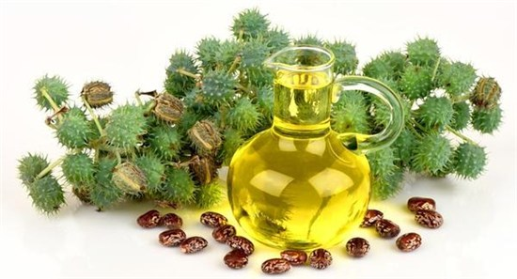
Castor Seed
Genetic breeding programs introduced new alternatives for the biodiesel industry. These programs aim at increasing the oil content of the seeds and modifying their FA composition to gain high quality and profitable yields.
In the case of castor oil, reduced levels of ricinoleic acid would lead to reduced biodiesel viscosity possibly meeting the ASTM limits.
Neat castor biodiesel viscosity was found to reach 13.75 mm²/sec, what is much larger than the ASTM limit of 6 mm²/sec.

Slide 5
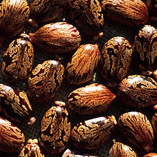
Castor Seed
Genetic breeding programs requires the screen of thousands of samples.
These is not realistic with standard analytical methods since they are considered exhaustive and environmentally unfriendly.
TD-NMR is a rapid and non-destructive technology that can be implemented for large-scale screening of intact oilseeds.

Slide 6
Standard Methods for Oil Content Measurement
The conventional technology used for oil extraction from oilseeds is by continuous solvent extraction Soxhlet.
The most common solvent used is hexane.
Disadvantages
Destructive method.
Long process.
Uses organic solvents.

Slide 7
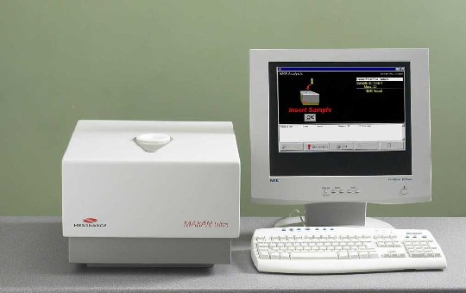
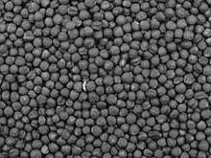
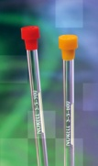

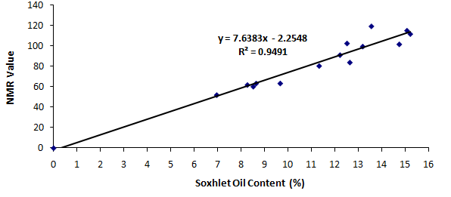

Low Field NMR - Total Fat content Application

Slide 8
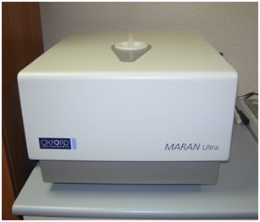
LR-NMR Method
Measure of T2 energy relaxation time of castor seeds using CPMG sequence.
Correlation between the T2 value and the amount of oil extracted from castor seeds of the same category.
Creation of a calibration curve specific for the castor seeds.

Slide 9
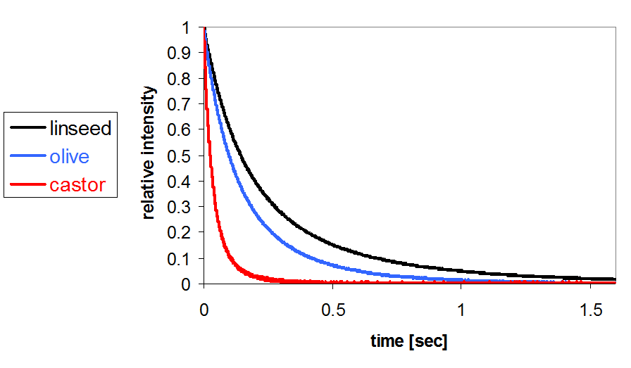
LR-NMR Method
Brief Summary – 1H relaxation of seed oils

Slide 10
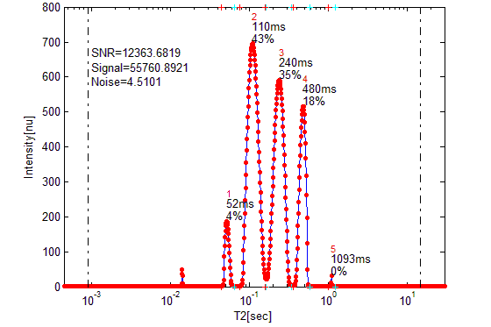
LR-NMR Method
Brief Summary – T2 of seed oil
Continuous distribution – TAGs:
Monoexponential T₂ - TAGs:
Pure materials:
Material | Monoexponential T₂ [ms]
FAMEs | 787 ± 8.24
TAGs | 216 ± 4.99
Methanol | ~3150
Glycerol | 51
Water | ~3600
Oleic acid | 344

Slide 11
LR-NMR Method
Example of a calibration curve to determine the oil content in castor seeds sample

Slide 12
T2 Expo Values (ms)
Updated Castor Seed Oil Calibration curve
(T2 NMR Values vs. Soxhelt % Oil)
% Oil by Soxhelt
בר קוד | ערכי NMR (ממוצע של 6 חזרות) | % שמן בסוקסלט (ממוצע של 2 חזרות)
1722239 | 3693 | 56
1722206 | 3593 | 52
1722288 | 3287 | 46
1722297 | 3220 | 46.4
1722294 | 3879 | 57.4
1721907 | 4154 | 60
1722154 | 3390 | 50
1722238 | 3820 | 56
1722299 | 3497 | 54
1721859 | 3792 | 55.1
1721862 | 3907 | 58
1722284 | 3784 | 55.5
C1008 | 3435 | 50.4

Slide 13
LR-NMR Method
Advantages
Non-destructive technology
Eco-friendly
large-scale screening of seeds
Specific calibration curves

Slide 14
Contact Information
Prof. Zeev Wiesman: wiesman@bgu.ac.il
Maysa Resende: mteixeiraresende@gmail.com
Dr. Janna Abramovich: janna@bgu.ac.il
Shosh Kravchick: kravch@bgu.ac.il
Plant Lipid Biotechnology Lab phone number: 074-7795272

